Slide 1
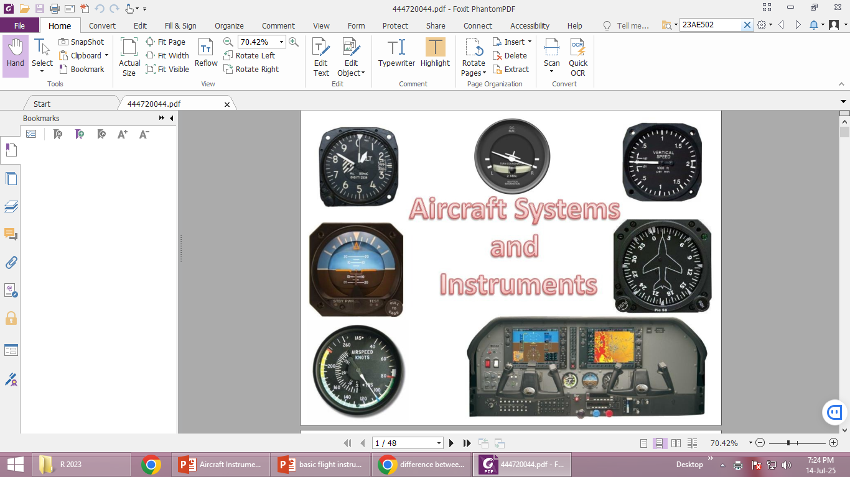
Aircraft Instruments

Slide 2
Types of Instruments
Primary Flight Instruments
Engine and Performance Instruments
Navigation Instruments and
Miscellaneous Instruments

Slide 3
Primary Flight Instruments
Airspeed Indicator (ASI) - Displays the speed of the aircraft relative to the air.
Attitude Indicator - Shows the aircraft's orientation relative to the horizon (pitch and roll).
Altimeter - Measures the aircraft's altitude above sea level.
Heading Indicator (HI) - Shows the aircraft’s current compass heading.
Vertical Speed Indicator (VSI) - Displays the rate of climb or descent.
Turn Coordinator - Indicates the rate of turn and the coordination (balance) of the turn.
Magnetic Compass - Shows the aircraft’s heading based on the magnetic field of the Earth.

Slide 4
Engine and Performance Instruments
Tachometer (RPM Indicator) - Displays engine revolutions per minute (RPM).
Manifold Pressure Gauge - Measures the pressure within the intake manifold of a piston engine.
Oil Pressure Gauge - Shows the oil pressure within the engine.
Oil Temperature Gauge - Displays the temperature of the engine oil.
Fuel Pressure Gauge - Indicates the pressure of the fuel being supplied to the engine.
Fuel Flow Indicator - Measures the rate of fuel consumption.
Exhaust Gas Temperature (EGT) - Shows the temperature of the exhaust gases, which helps monitor engine performance.
Cylinder Head Temperature (CHT) - Indicates the temperature of the engine's cylinder heads.

Slide 5
Navigation Instruments
VOR Indicator - Displays information from the VOR (VHF Omnidirectional Range) navigation aid.
ADF (Automatic Direction Finder) - Displays the direction to a non-directional beacon (NDB).
GPS (Global Positioning System) - Shows the aircraft’s position using satellite-based navigation.
DME (Distance Measuring Equipment) - Displays the distance to a navigation aid.
ILS (Instrument Landing System) - A system used to guide aircraft during the approach phase to landing.

Slide 6
Miscellaneous Instruments
Pitot Tube - Measures the dynamic pressure, which is used to calculate airspeed.
Static Port - Measures the static pressure, used to calculate altitude, vertical speed and airspeed.
Turn and Slip Indicator - Shows if the aircraft is making a coordinated turn or is skidding/slipping.
Climb Rate Indicator - Measures the rate of climb or descent, often integrated into the VSI.
Yaw Indicator - Measures the yawing movement of the aircraft.

Slide 7
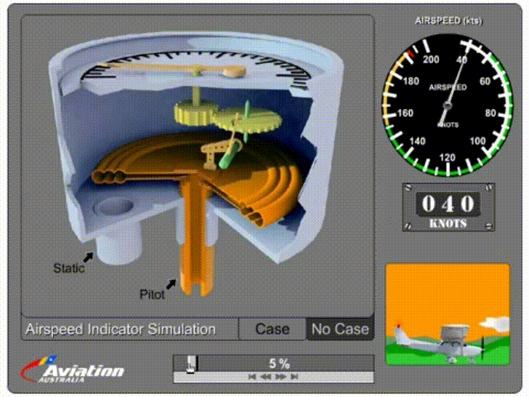
Airspeed Indicator

Slide 8
Airspeed Indicator
The ASI uses the pressure differential in the Pitot-static system to measure and display the aircraft’s speed. In most aircraft the ASI displays speed in knots or miles per hour.
A needle points shows the aircraft’s current indicated air speed (IAS). Standard color-coded markings provide various critical speed information for that model of aircraft, including stall, flap setting, normal operating, caution and never exceed speeds.
The table below shows what the colors on an airspeed indicator mean.

Slide 9
Airspeed Indicator Markings
Marking Color | Type | Meaning
White | Arc | Flap operating range Bottom: Flaps-down stall speed Top : Maximum airspeed for full flaps extended
Green | Arc | Normal operating range Bottom: Flaps-up stall speed Top: Maximum structural cruising speed
Blue | Line | Airspeed for best single-engine rate-of-climb at gross weight and sea level
Yellow | Arc | Caution area Bottom: Maximum structural cruising speed Top: Never exceed speed
Red | Line | Never exceed speed

Slide 10
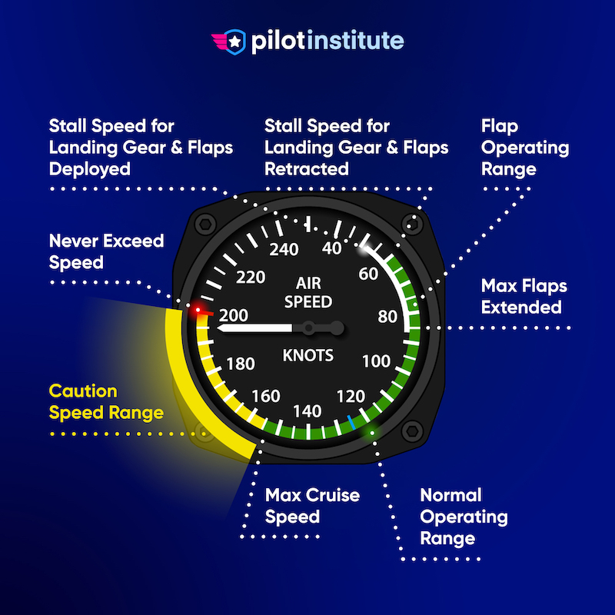

Slide 11
Working of airspeed indicator
The ASI is the only flight instrument that uses both the static system and the pitot system. Static pressure enters the ASI case, while total pressure flexes the diaphragm, which is connected to the ASI pointer via mechanical linkage.
The pressures are equal when the aircraft is stationary on the ground, and hence shows a reading of zero. When the aircraft is moving forward, air entering the pitot tube is at a greater pressure than the static line, which flexes the diaphragm, moving the pointer.
The pitot tube may become blocked, because of insects, dirt or failure to remove the pitot cover. A blockage will prevent ram air from entering the system. If the pitot opening is blocked, but the drain hole is open, the system pressure will drop to ambient pressure, and the ASI pointer will drop to a zero reading. If both the opening and drain holes are blocked, the ASI will not indicate any change in airspeed.

Slide 12
Attitude Indicator (AI)
Also known as the artificial horizon, the AI uses a rigidly-mounted internal gyro to display the aircraft’s attitude relative to the horizon. The display consists of an aircraft aligned to the horizon in straight-and-level flight, with a blue sky above and brown or black ground below.
A vertical scale crossing the horizon shows degrees of pitch up or down. A curved scale across the top shows degrees of bank left or right. When the aircraft changes pitch or direction, the aircraft essentially rotates around the AI’s gyro and the instrument display responds accordingly.

Slide 13


Slide 14
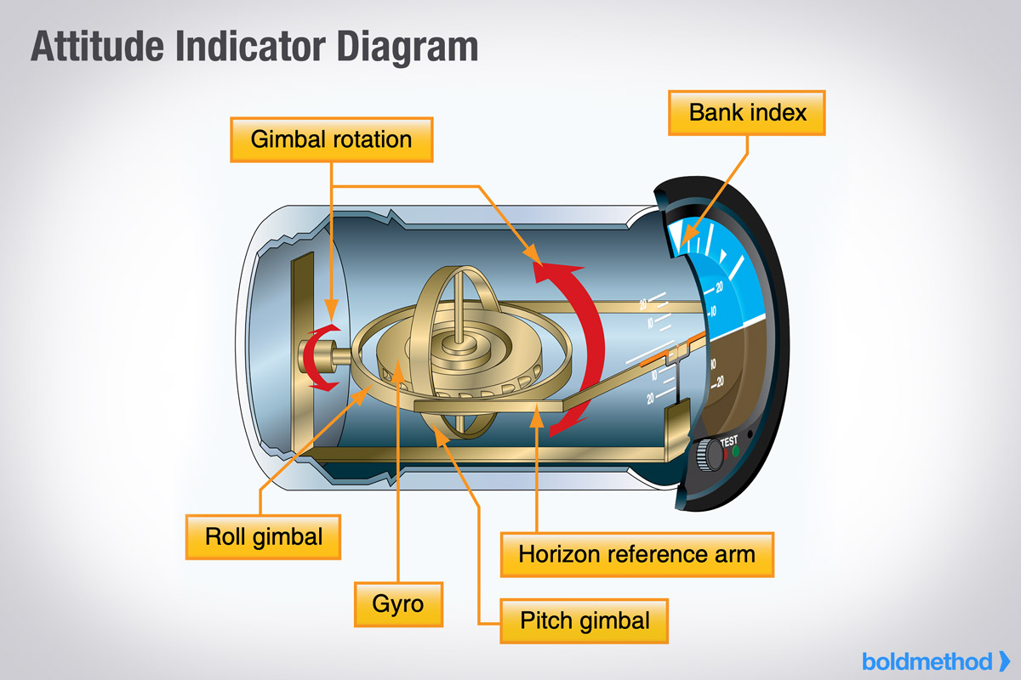

Slide 15
Gyroscope
A gyroscope is a device used for measuring or maintaining orientation and angular velocity. It works on the principle of conservation of angular momentum.
A spinning rotor, mounted on gimbals, resists changes to its orientation, allowing it to maintain a fixed direction in space even as its base is moved. This resistance to orientation change is due to the rotor's angular momentum, which tends to stay constant unless acted upon by an external torque.

Slide 16
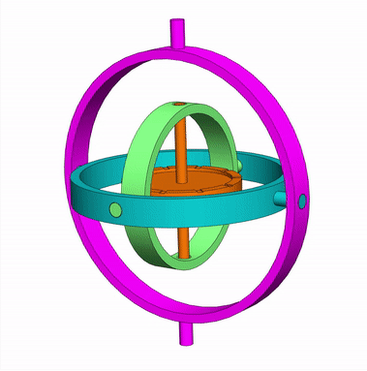
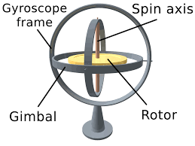

Slide 17
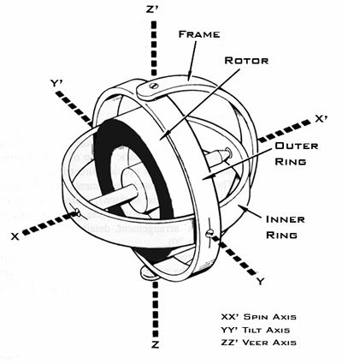
Spin axis is the axis around which the rotor spins.
Tilt axis is the axis about which the gyroscope's spin axis can rotate (or "tilt") in a vertical plane.
Veer axis is the axis about which the gyroscope's spin axis can rotate (or "veer") in a horizontal plane.

Slide 18
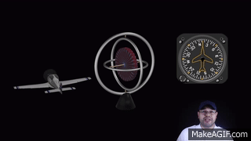

Slide 19
Altimeter
The altimeter uses barometric pressure (atmospheric pressure) obtained from the static port to display the aircraft’s approximate altitude or height above mean sea level (MSL) in feet. These pointers provide the altitude information.
Because barometric pressure changes with altitude and atmospheric conditions, most altimeters contain an adjustment knob to dial in the local barometric pressure (also known as the altimeter baro setting).

Slide 20
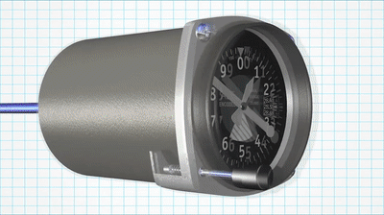

Slide 21
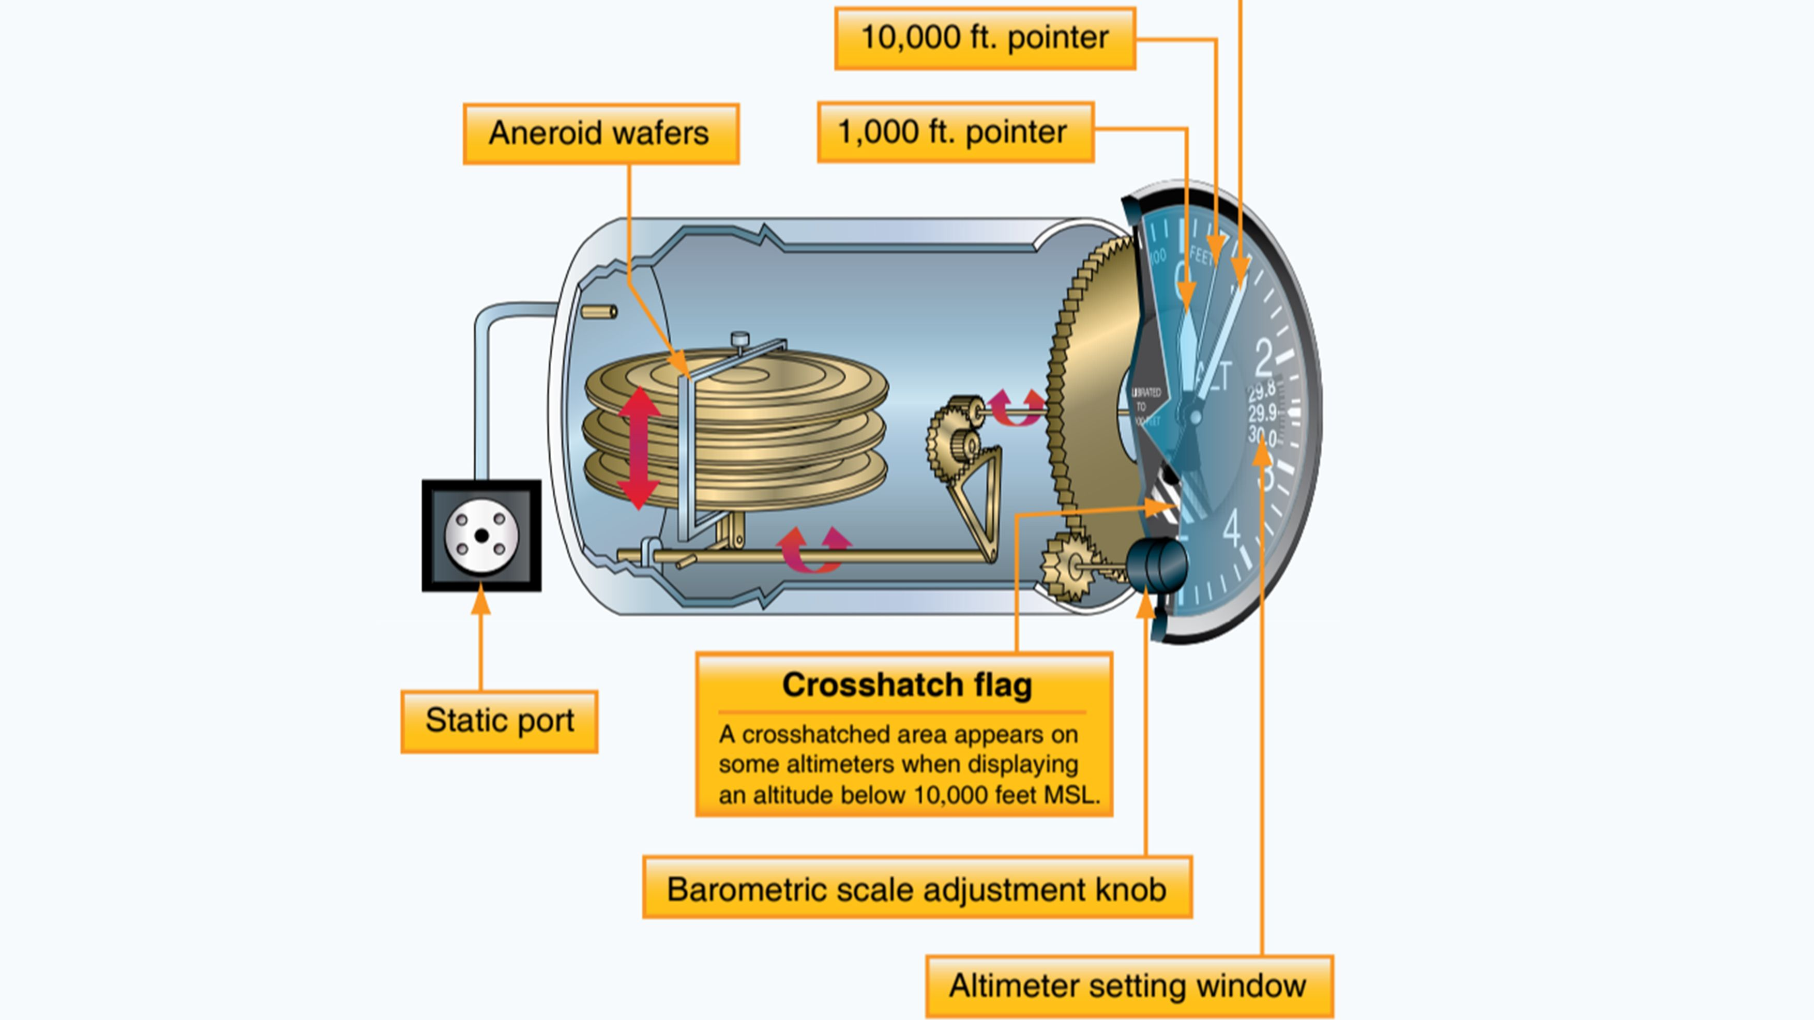
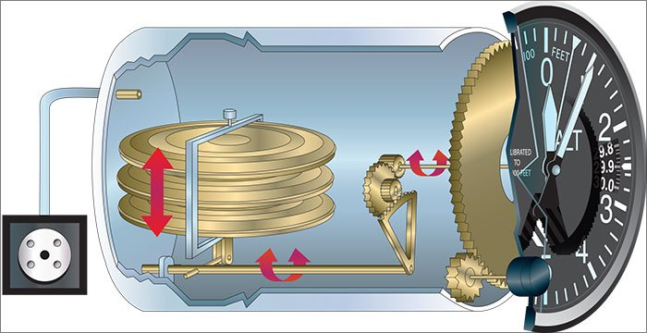

Slide 22
Turn Coordinator (TC)
One indicates the rate of turn or the rate of change in the aircraft's heading; the other part indicates whether the aircraft is in coordinated flight, showing the slip or skid of the turn.
Note that the TC is not meant to indicate a bank angle, just rate and direction of turn. The TC may include a liquid-filled inclinometer that provides slip or skid information.

Slide 23


Slide 24
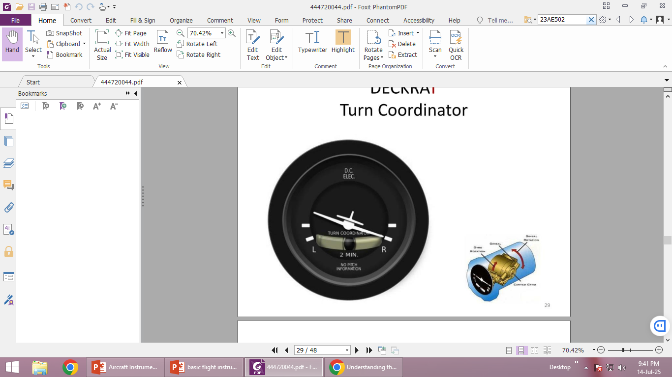

Slide 25
Heading Indicator (HI)
The HI uses a rotating gyro to display the current compass direction (otherwise known as the heading) that the aircraft is flying.
Using a 360-degree compass card with north as zero or “N,” the HI shows headings in 5-degree increments with every 30 degrees enumerated. To reduce crowding, the last “zero” of the heading is omitted ”3” is 30 degrees, “12” is 120, etc.
An adjustment knob turns the internal HI compass card to align with the aircraft’s magnetic compass.

Slide 26
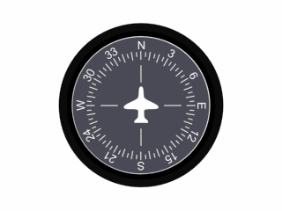

Slide 27
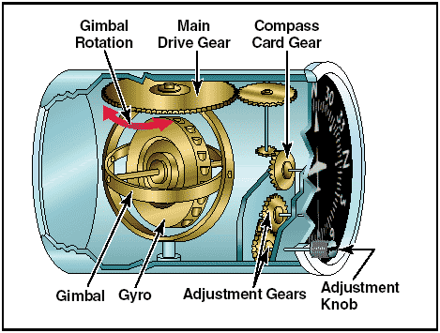

Slide 28
Vertical Speed Indicator (VSI)
The VSI uses internal pressure differential to provide a visual indication of how fast the aircraft is climbing or descending.
A diaphragm with chambers connected to the static port expands or contracts in response to climbs and descents, causing the instrument to indicate the rate of climb or descent in hundreds of feet per minute (fpm).
A hole in the diaphragm releases the pressure change to return to zero rate when no change is occurring.

Slide 29
When the aircraft climbs, the static pressure decreases, which allows the pressure inside the case to compress the aneroid and move the pointer upward to show a climb.
Conversely, when the aircraft descends, the static pressure increases, allowing the aneroid to expand and move the needle downward to show a descent.
When the aircraft levels off, the pressure inside the case equals the pressure inside the aneroid and the indicator points to zero.

Slide 30
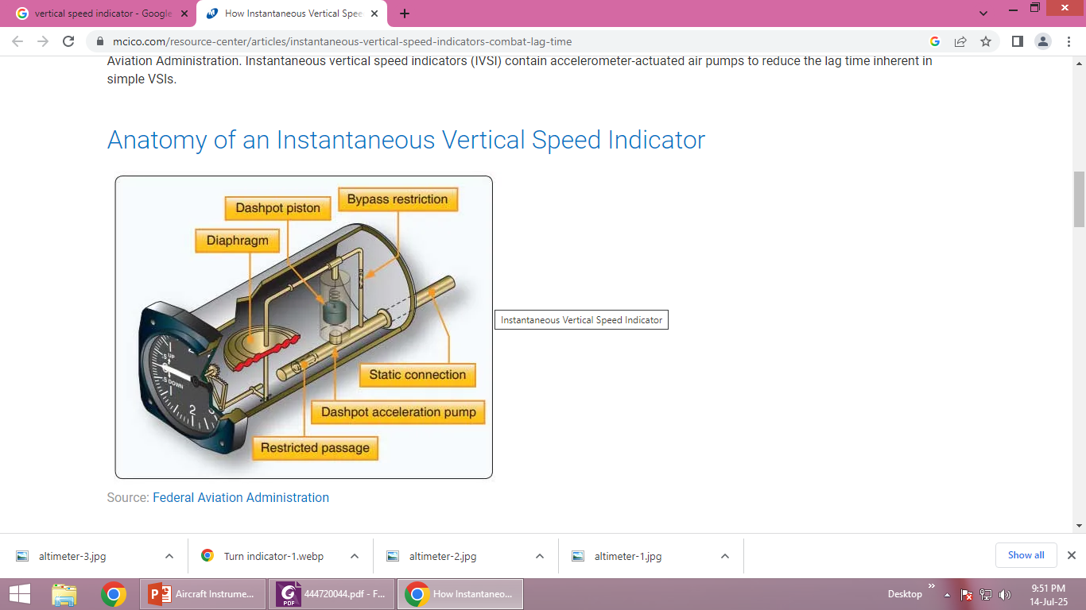

Slide 31
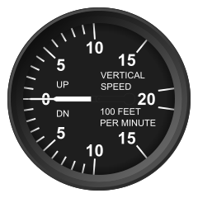

Slide 32
Thank you

